Slide 1
What Dark Souls Character are you?
With lore!

Slide 2
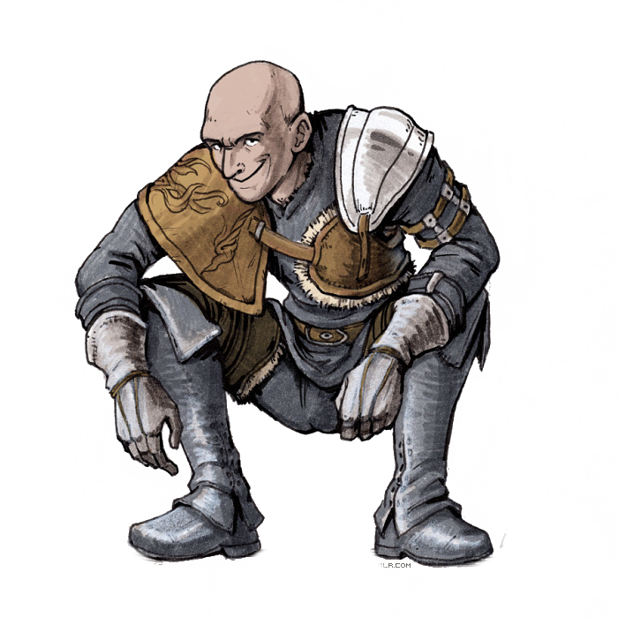
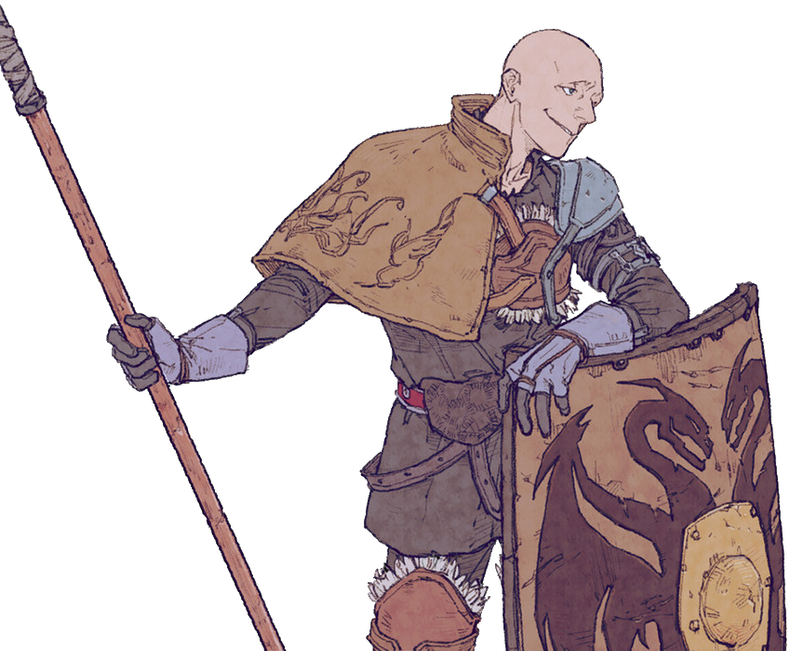
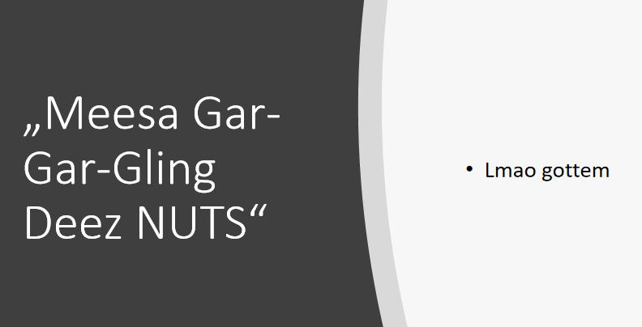
Jarex the Unbreakable
Will trick you in a Deez Nuts joke whenever and however he can
Might kick you in a pit, but only for your good will
Has deep feelings but doesn’t want to show them because he’s unbreakable
Has a tool for literally any occasion
Will help his friends when in need, just in his own way
Is bald (sorry jarex jkjk…. unless?)
Somehow never goes insane despite the world crumbling around him
"Shame on you, you greedy guts. Thought you could outwit an onion? Well, say hello to the nice giant! He adores visitors." (laughs hysterically)"

Slide 3
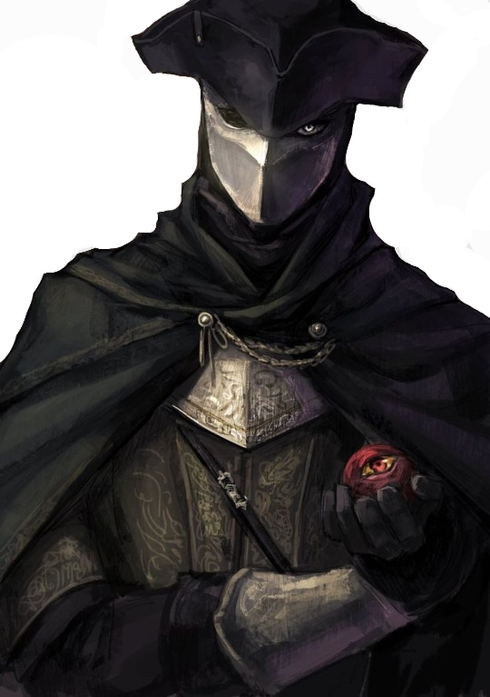
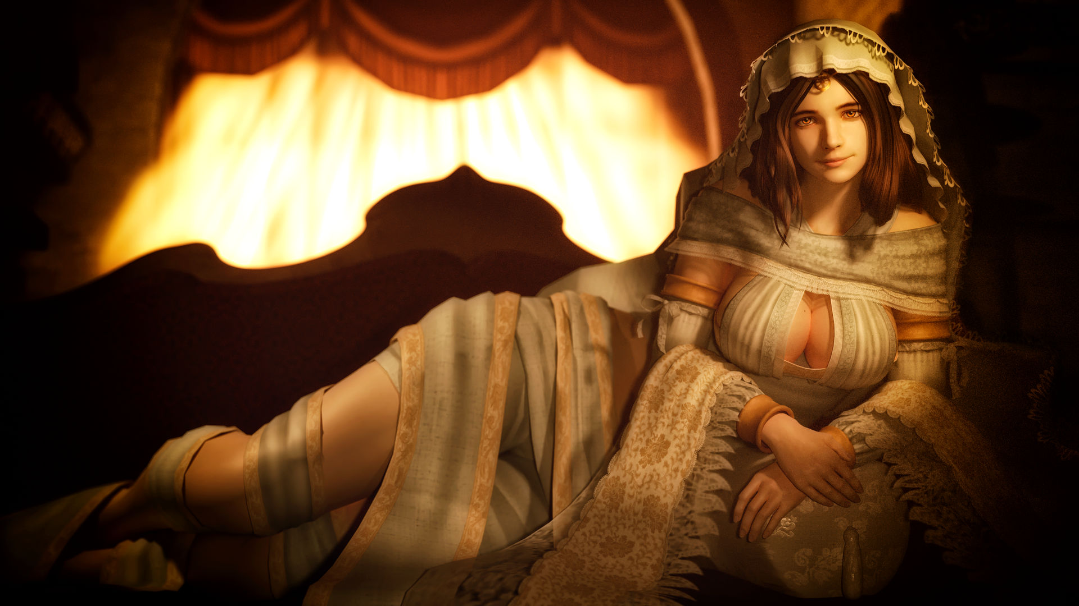
Ringfinger Poke
Sometimes slightly edgy
Sometimes also a simp
Will protect her queen no matter what (will kill her and guard her soul if necessary)
Has inner tendencies of pillaging and plundering
Might partake in a war
Will partake in a war, if asked by his goddess
Will fetch you a tongue if you’re missing one
The goddess ←
“And now you want to ravage her soul, as well. I sowed the seeds. I'll prune the mess. I, Leonhard, swear so upon my vows to the goddess."

Slide 4
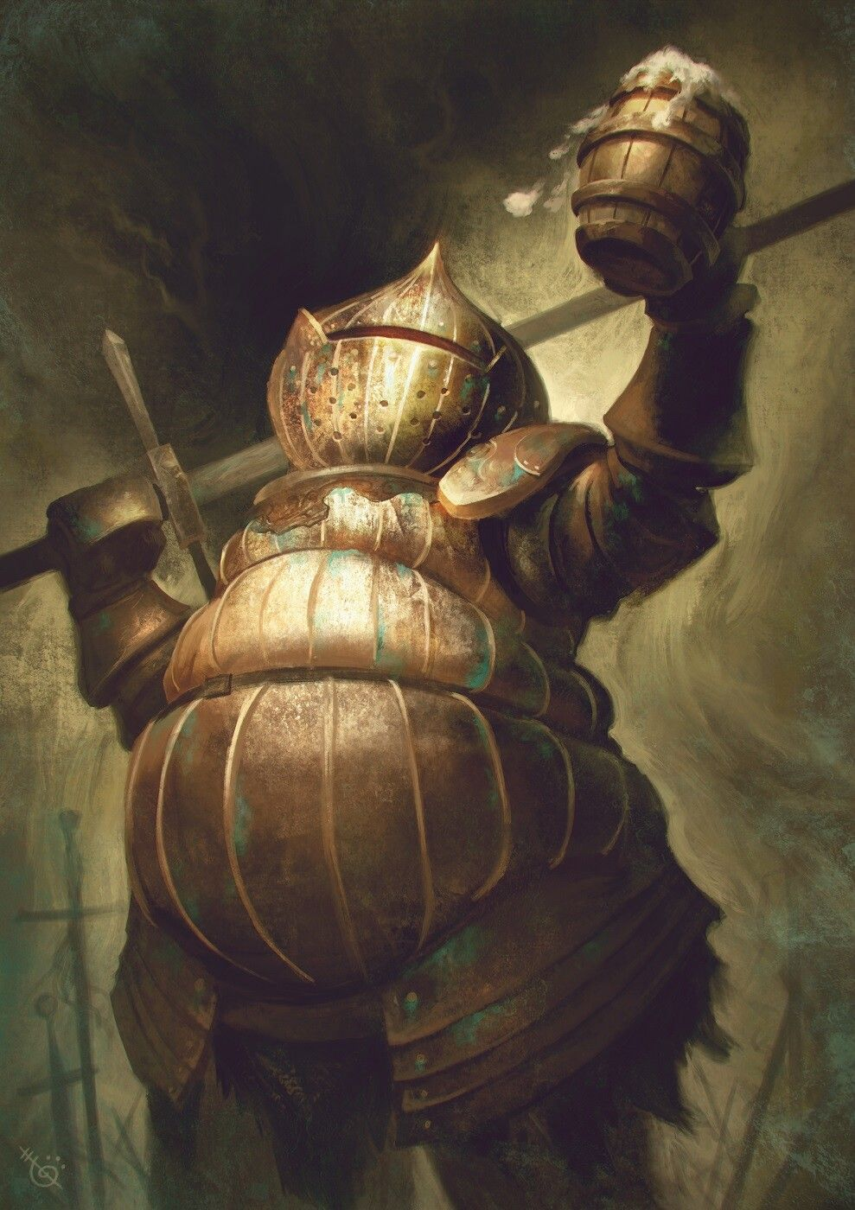
Carmen of Catarina
Absolute friend
Will go to great lengths to fulfill promises (ride elevators, fight old demons, walk through forgotten cities, escape jail)
Is a great moral support, even after you’ve died a dozen times to Curserotted Greatwood
Has a wholesome laugh
Will probably make you a whacky drink after a nice fight with a giant undead king
Loves to talk about all the spice and spilled beans/tea
Probably likes onions
Probably likes booze
“…But for the moment, we’ve a oast to make.To your valor, my sword, and our victory together. Long may the Sun shine!”

Slide 5
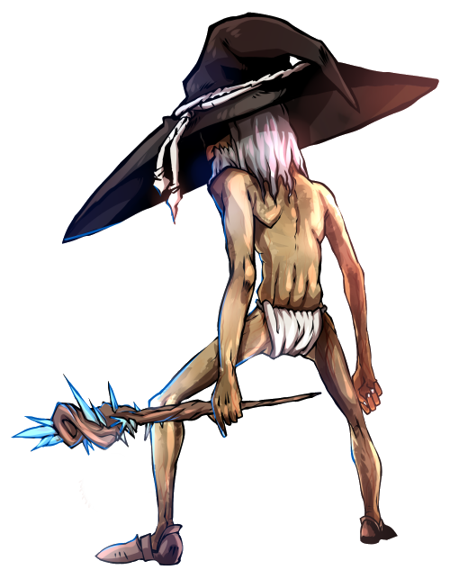
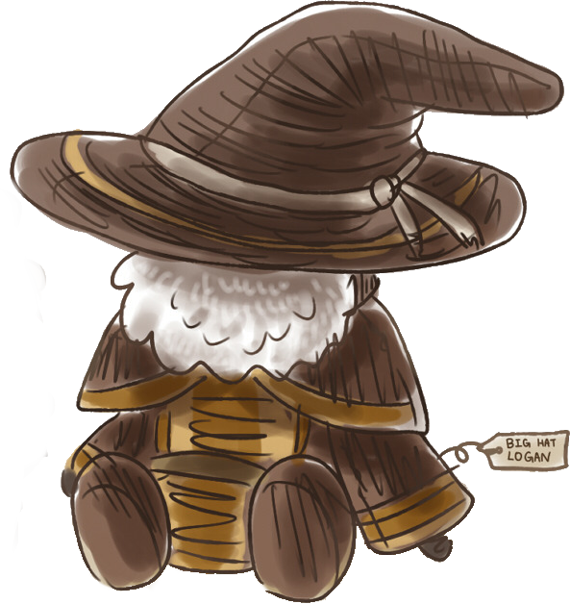
Big Hat Lupus
Is a Wizard, and has a big hat (probably)
Wants to know the secrets of the entire universe, and nothing will stop him from conquering the deepest knowledge regarding anything in our world.
Is a very cool guy
Will teach you stuff when you don’t know
Will offer good advice when you ask him, but often forgets things
Hides a mind corrupted by the maddening dark of the abyss which he witnessed in his search for the unkown.
Has beautiful hair (but not a beard).
“Hmm…hmm…(Gibberish)
“Oh, do not fret. You will find your own way. Don’t frown with regret: peer forward with your head held high”

Slide 6
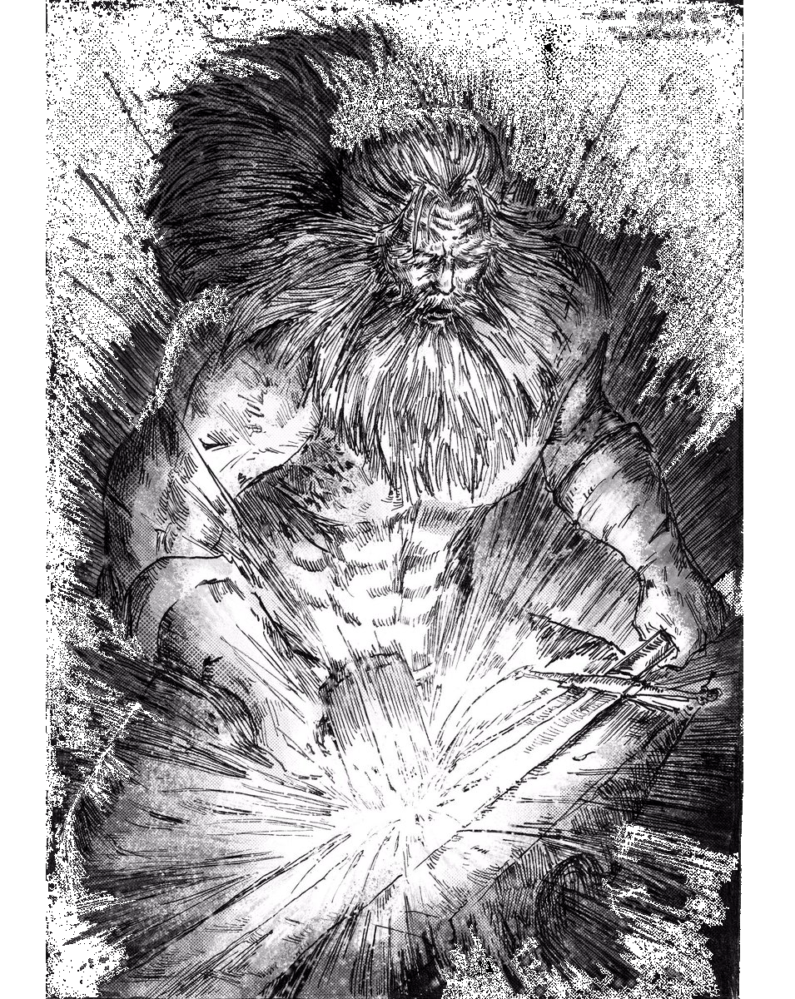
Blacksmith Kimo
Ancient, like the land… or maybe not, no one knows really. Do you? I don’t.
Can make, fix and destroy things all with the same ease.
Dad energy, is responsible and will tell you what you do wrong.
“It’s fine to be Undead, but keep a leveled head huh?! HAHAHA”
Will thank you if you give him some precious coal
Likes to plays dwarves in dnd
Will scold you if you break the sword he made for you
Has lots of patient. When it runs out, he will bash your skull with a sledgehammer
You wrong him once, he’ll never forget
Probably befriended a giant once in his life

Slide 7
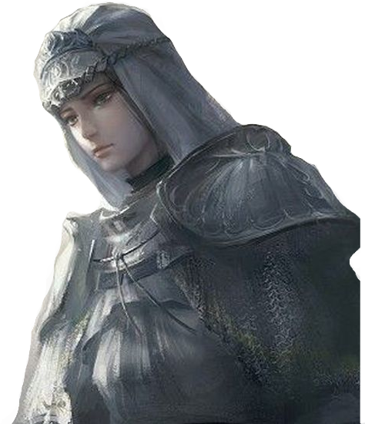
Amber of the Sunless Realms
Comes from a realm without sun (there’s no sun in the netherlands from now on)
Will be a loyal friend and help you if you need
Is a bad bitch
Will murder you, with words or a rapier, if she doesn’t like you
Really loves her family, has a lovely Oma
Would also slap his friends if they ever misbehaved
Will take some time before she can say you’re a real friend of hers
Will take some time to trust you. Understandably so
Has so much cool shit you might kill her for it… or you could just do her quest instead of stabbing her in the back.
Is physically fragile. Has less hp than a sorcerer.
"If you require help on your travels, I offer you my sign. Blessing of the moon upon your journey."

Slide 8
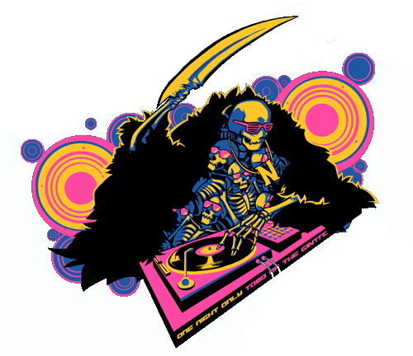
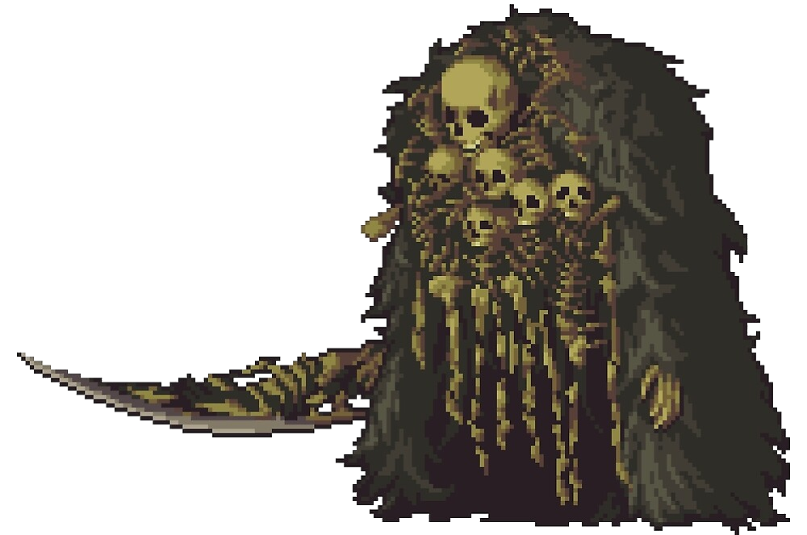
Gravelord Barth
Meme king
Sometimes serious, sometimes will pull out a meme. Who knows when he’s what
A scholar, informed in many subjects. He knows 10 facts for every fact you know
Does NOT possess a Lord soul, but will possess the power to deliver death onto people once he starts working as a lawyer.
Will correct you if you are wrong.
Would go back to his thousands-year long slumber in a coffin deep underneath the earth instead of studying.
Is a good boi
Maybe made of skulls and skeletons
Will rave
“That’s fucking nito brother."

